Slide 1
Lending Club Case Study
Group Members Priyanshu Kumar
Rajani Malle

Slide 2
Case Study Objectives
Identifications of attributes that result in non repayment of the loan
Identify the driving factors by studying the data for the loan repayment
Recommend the safe practices for sanctioning of the loans

Slide 3
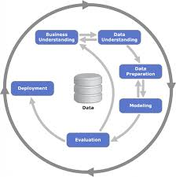
Various steps taken in EDA to solve the problem
Data understanding
Data Cleaning
Data Preparation
Exploratory Data Analysis
* Univariate Analysis
* Bivariate Analysis
* Segmented Univariate Analysis

Slide 4
Data Cleaning Steps Followed
Fixing Rows and Columns: - Removing of unwanted rows and columns according to the business use case and the target variable
Fixing missing values :- Removing the row or prefilling the row with missing values so that the data could lead us to a meaningful analysis
Standardising Values : Making the values into the standard format for the analysis for example we can remove the % sign from a row value , or converting the units into a standard unit and removing outliers
Invalid Values :- Removing values from the data that are not null but are invalid and mislead the analysis

Slide 5
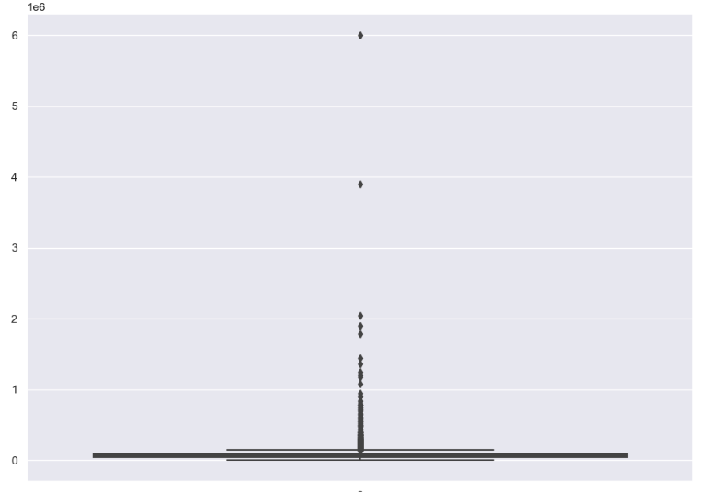
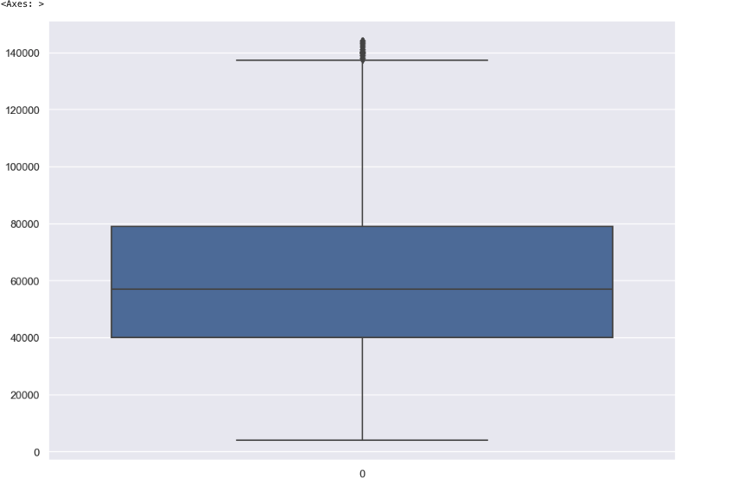
Removing Outliers
Here we had a outlier for the annual_inc hence we had to remove it using the quantile method here are the results before and after

Slide 6
Some of the Important Graphs from our Analysis

Slide 7
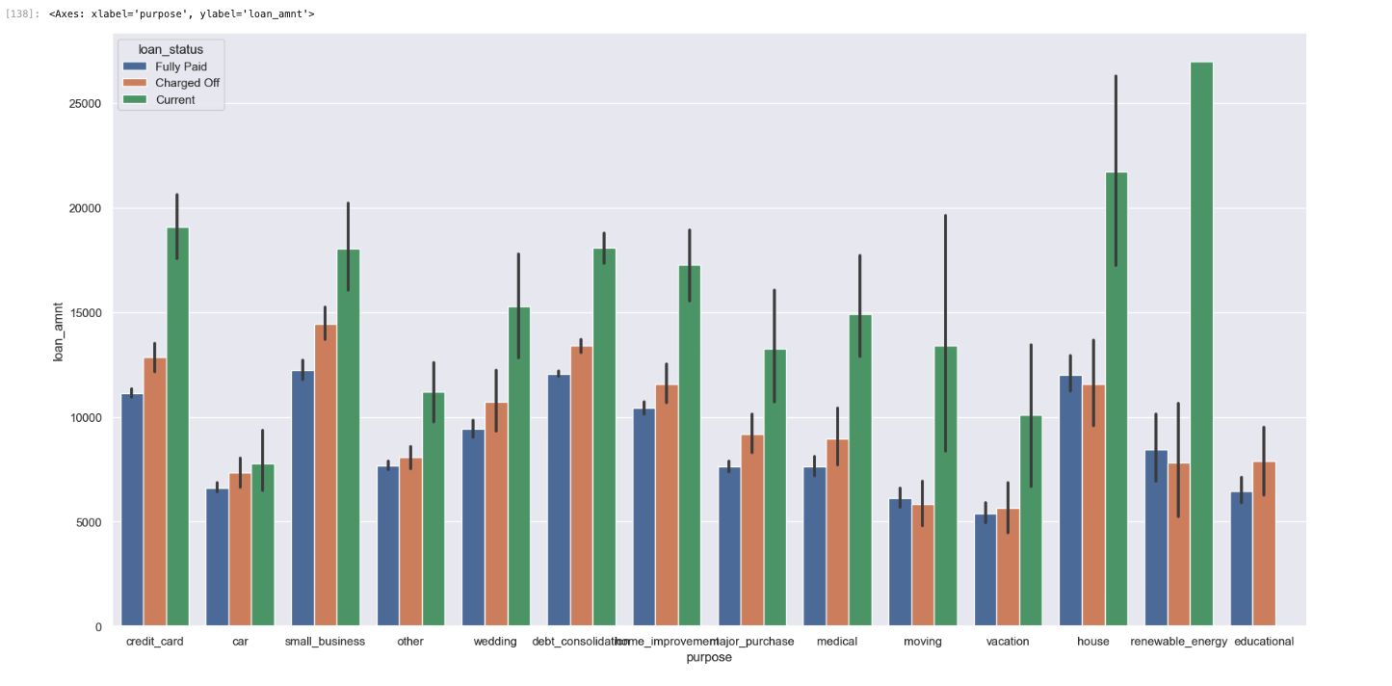
Comparing loan Amount vs Loan Purpose
Findings
* From the graph we can conclude that the maximum loan were charged off in the following categories credit card , small business, debt consolidation and house
* Credit card and debt consolidation being the major risky sectors for giving out the loan

Slide 8
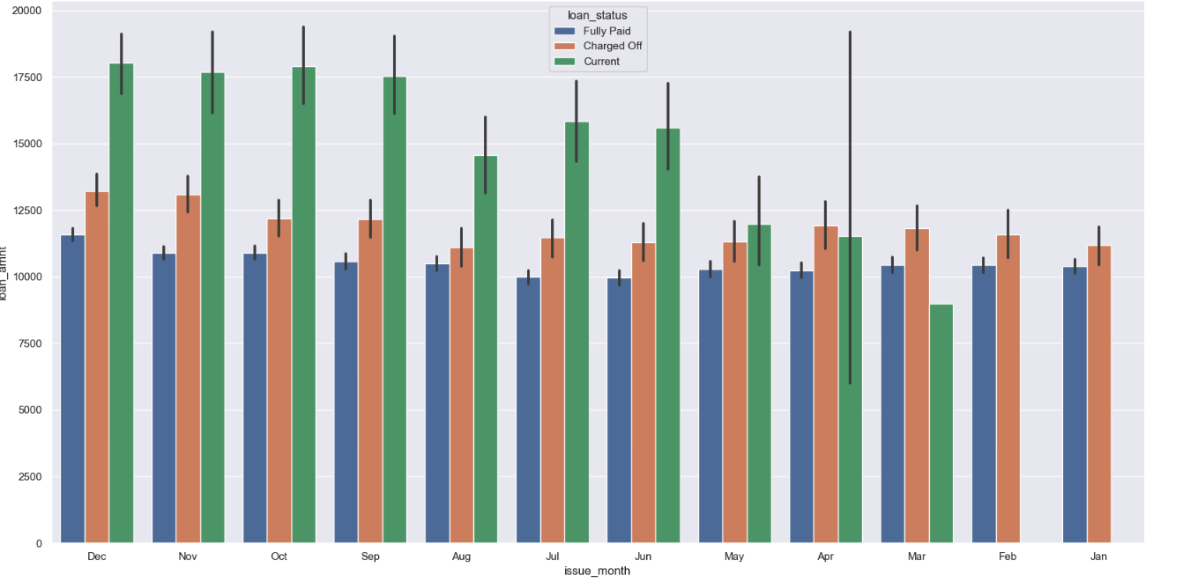
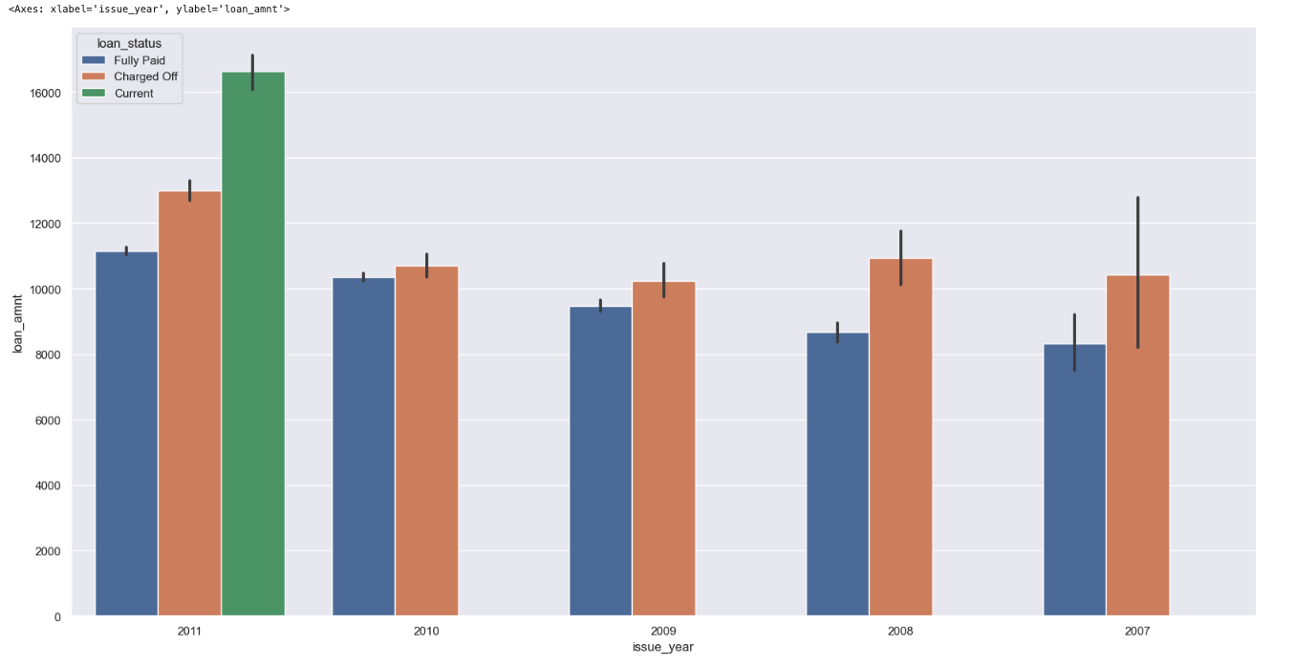
Comparing Years and months vs the loan status
Findings
* From the above graphs we can conclude that most of the defaults happened in the later months of the year like sep, out, nov, dec
* From the year vs the loan status graph we can conclude that a high number of loans were charged off in the year 2011

Slide 9
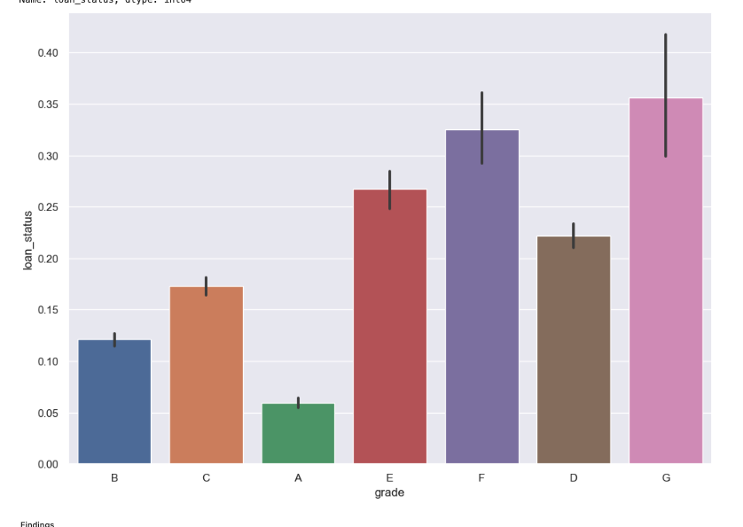
Loan Status VS Grade Risk Analysis
Findings
* From the above graphs we can conclude that grade G and F loans are the most risky loans to be given

Slide 10
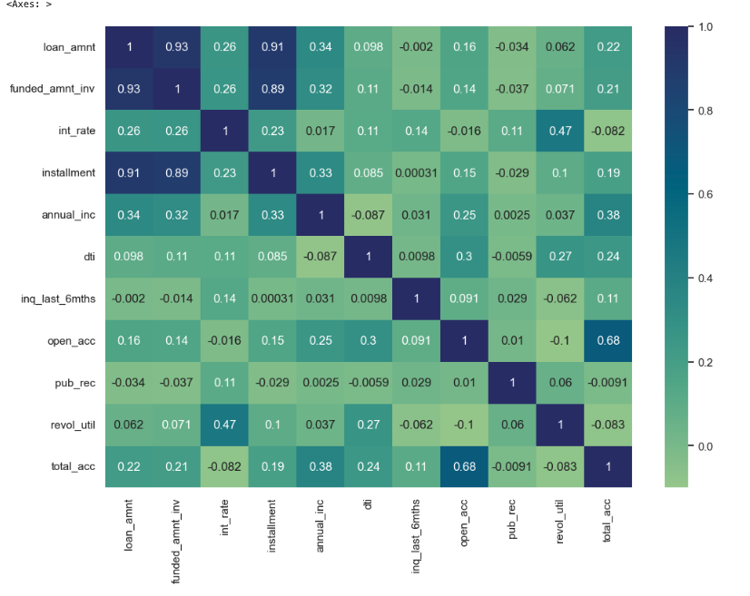
Co-Relation between All the numerical values
Findings
* Open accounts is positively correlated with the total accounts
* Installment is positively correlated with the loan_amnt and funded_amnt_inv

Slide 11
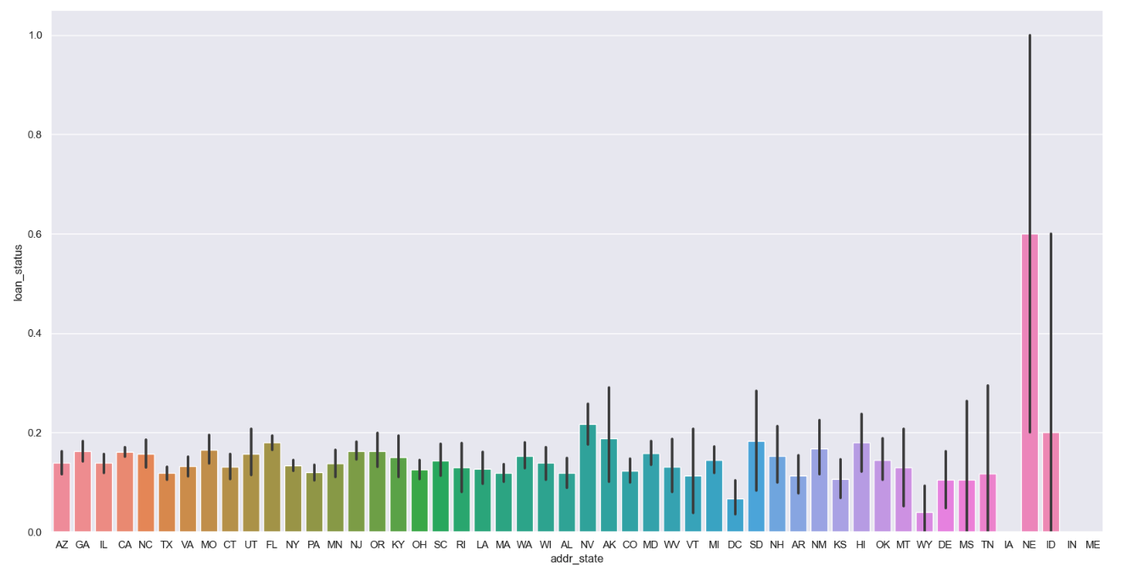
Comparing address state data with the loan status
Findings
* We see a high number of defaults from states like NE,ID,and NV, Where NE being the extremely highest

Slide 12
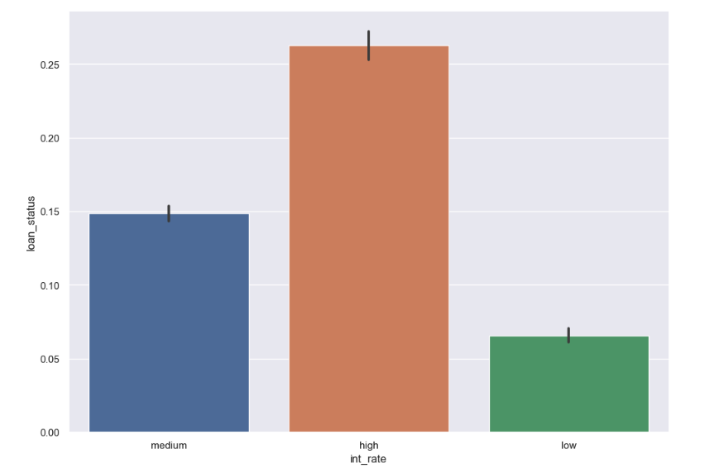
Segmented analysis for a relation between the interest rate and the loan status
Findings
* High Interest Rates have a higher probability of the defaults

Slide 13
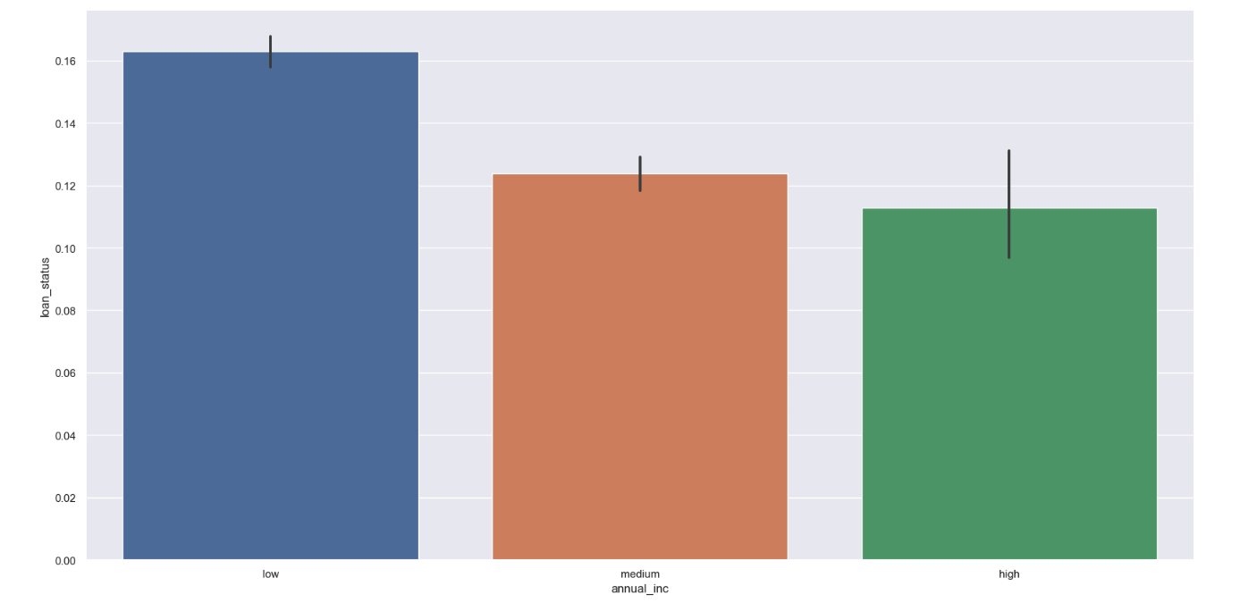
Segmented analysis for a relation between the Annual income and the loan status
Findings
* Lower the annual income is higher is the risk for the loan defaults

Slide 14
Conclusions
The following factors highly determine the loan defaulting outcomes
* Interest Rate
* Annual Income
* DTI
* Verification Status

Slide 15
Other Factors affecting outcome
* Grade G and F loans are the most risky loans to be given
* Most of the defaults happened in the later months of the year like sep, out, nov, dec
* Credit card and debt consolidation being the major risky sectors for giving out the loan
* We see a High Number of defaults from states like NE,ID,and NV, Where NE being the extremely highest
* Risk increases as the sub grade of loan increases example A1 A2 A3 so on
* Most of the people who default loan have been charged a higher interest rate
* Most of the people who default loan have a slightly lower annual income

